Slide 1


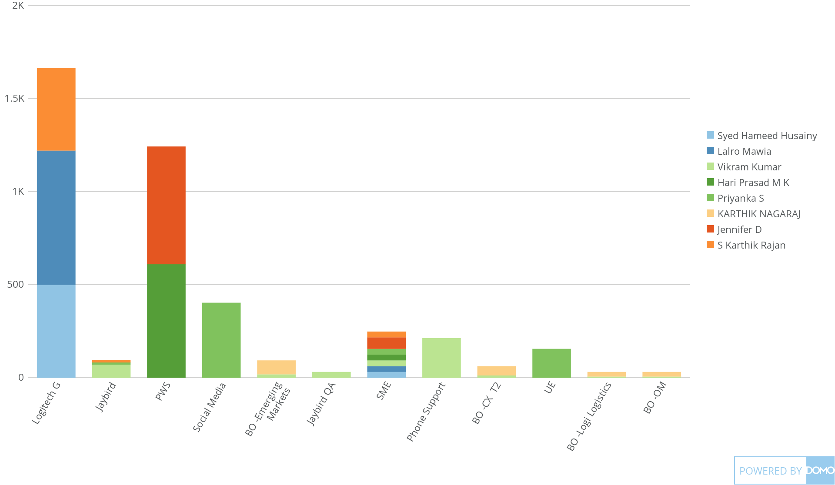
+
exported Apr 6, 2025, 12:45:00 AM MDT
TL| Wise Attendance
Jan 1, 2025 - Jan 31, 2025
4K Count of LOB

